Slide 1
Sequential Circuits

Slide 2
What we have learned in the last lecture
- Devices that can carry out one step of operation
• What they can’t do
- “Remember” history of operations
- Carry out a sequence of operations in which later operations depend on results of previous ones

Slide 3
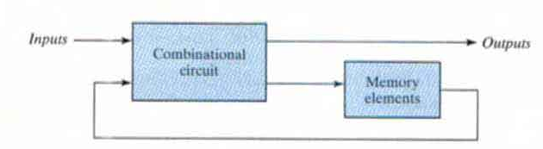
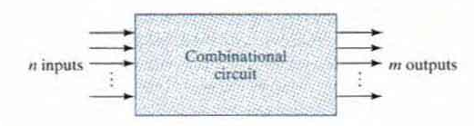
• Combinational circuits
- Outputs determined solely by inputs
• Sequential Circuits
- Characterized by feedbacks
- Outputs determined by inputs and previous outputs

Slide 4
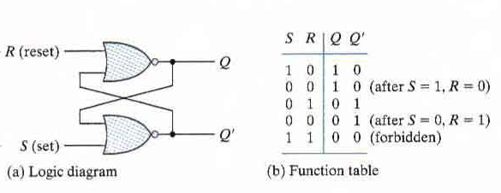
Flip Flops
A flip-flop
- A smallest sequential circuit
- Can “remember” a bit of information
SR latch

Slide 5
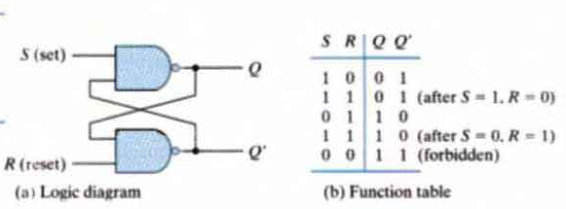

Slide 6
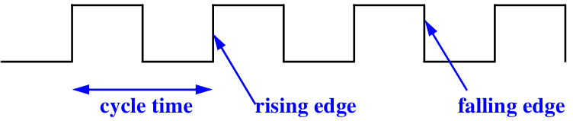
Clock Pulses/Signals
a clock signal is a particular type of signal that oscillates between a high and a low state

Slide 7
Edge-Triggered Flip-flops
Output changes state at a specified point on a triggering input called the clock.
Change state either at the positive edge (rising edge) or at the negative edge (falling edge) of the clock signal.

Slide 8
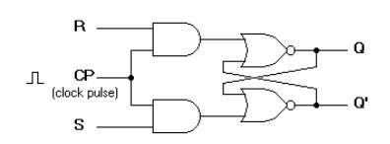
Clocked SR Flip Flop
When CK = 0, the value of Q does not change
When CK = 1, the circuit acts like an ordinary S-R flip-flop
S | R | Q(t) | Q(t+1)
0 | 0 | 0 | 0 | No change
0 | 0 | 1 | 1
0 | 1 | 0 | 0 | Reset
0 | 1 | 1 | 0
1 | 0 | 0 | 1 | Set
1 | 0 | 1 | 1
1 | 1 | 0 | x | Indeterminate
1 | 1 | 1 | x

Slide 9
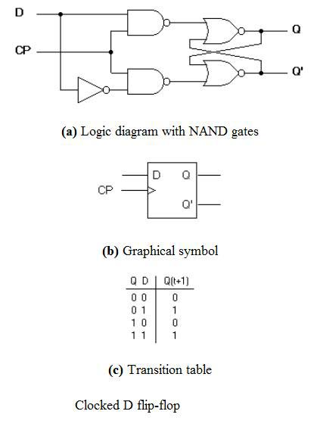
D Flip Flop
The output terminals Q and Q’ behave just as in the S-R flip-flop.
Q changes only when the clock signal CP makes a positive transition.

Slide 10
1
Clock
0 0
time
Value of D is read into the latch.
Value of D is remains in the latch.

Slide 11
Uses of Flip Flops - Registers
Using D Flip Flops you can build a register which will only pass data on when the clock triggers.
D0-D7 are the data bus lines from the memory.
R0-R7 is an 8 bit register.
R0
R1
R2
R3
R4
R5
R6
R7
Q
Q
Q
Q
Q
Q
Q
Q
C
D
C
D
C
D
C
D
C
D
C
D
C
D
C
D
Clock
D0
D1
D2
D3
D4
D5
D6
D7

